Slide 1
Transitioning to
Adult Services

Slide 2
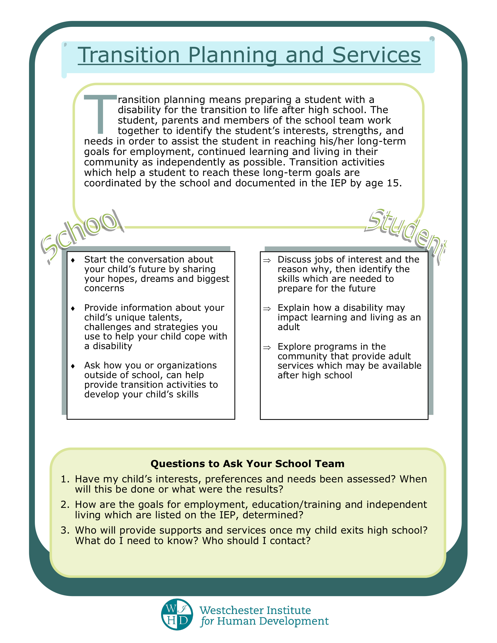

Slide 3
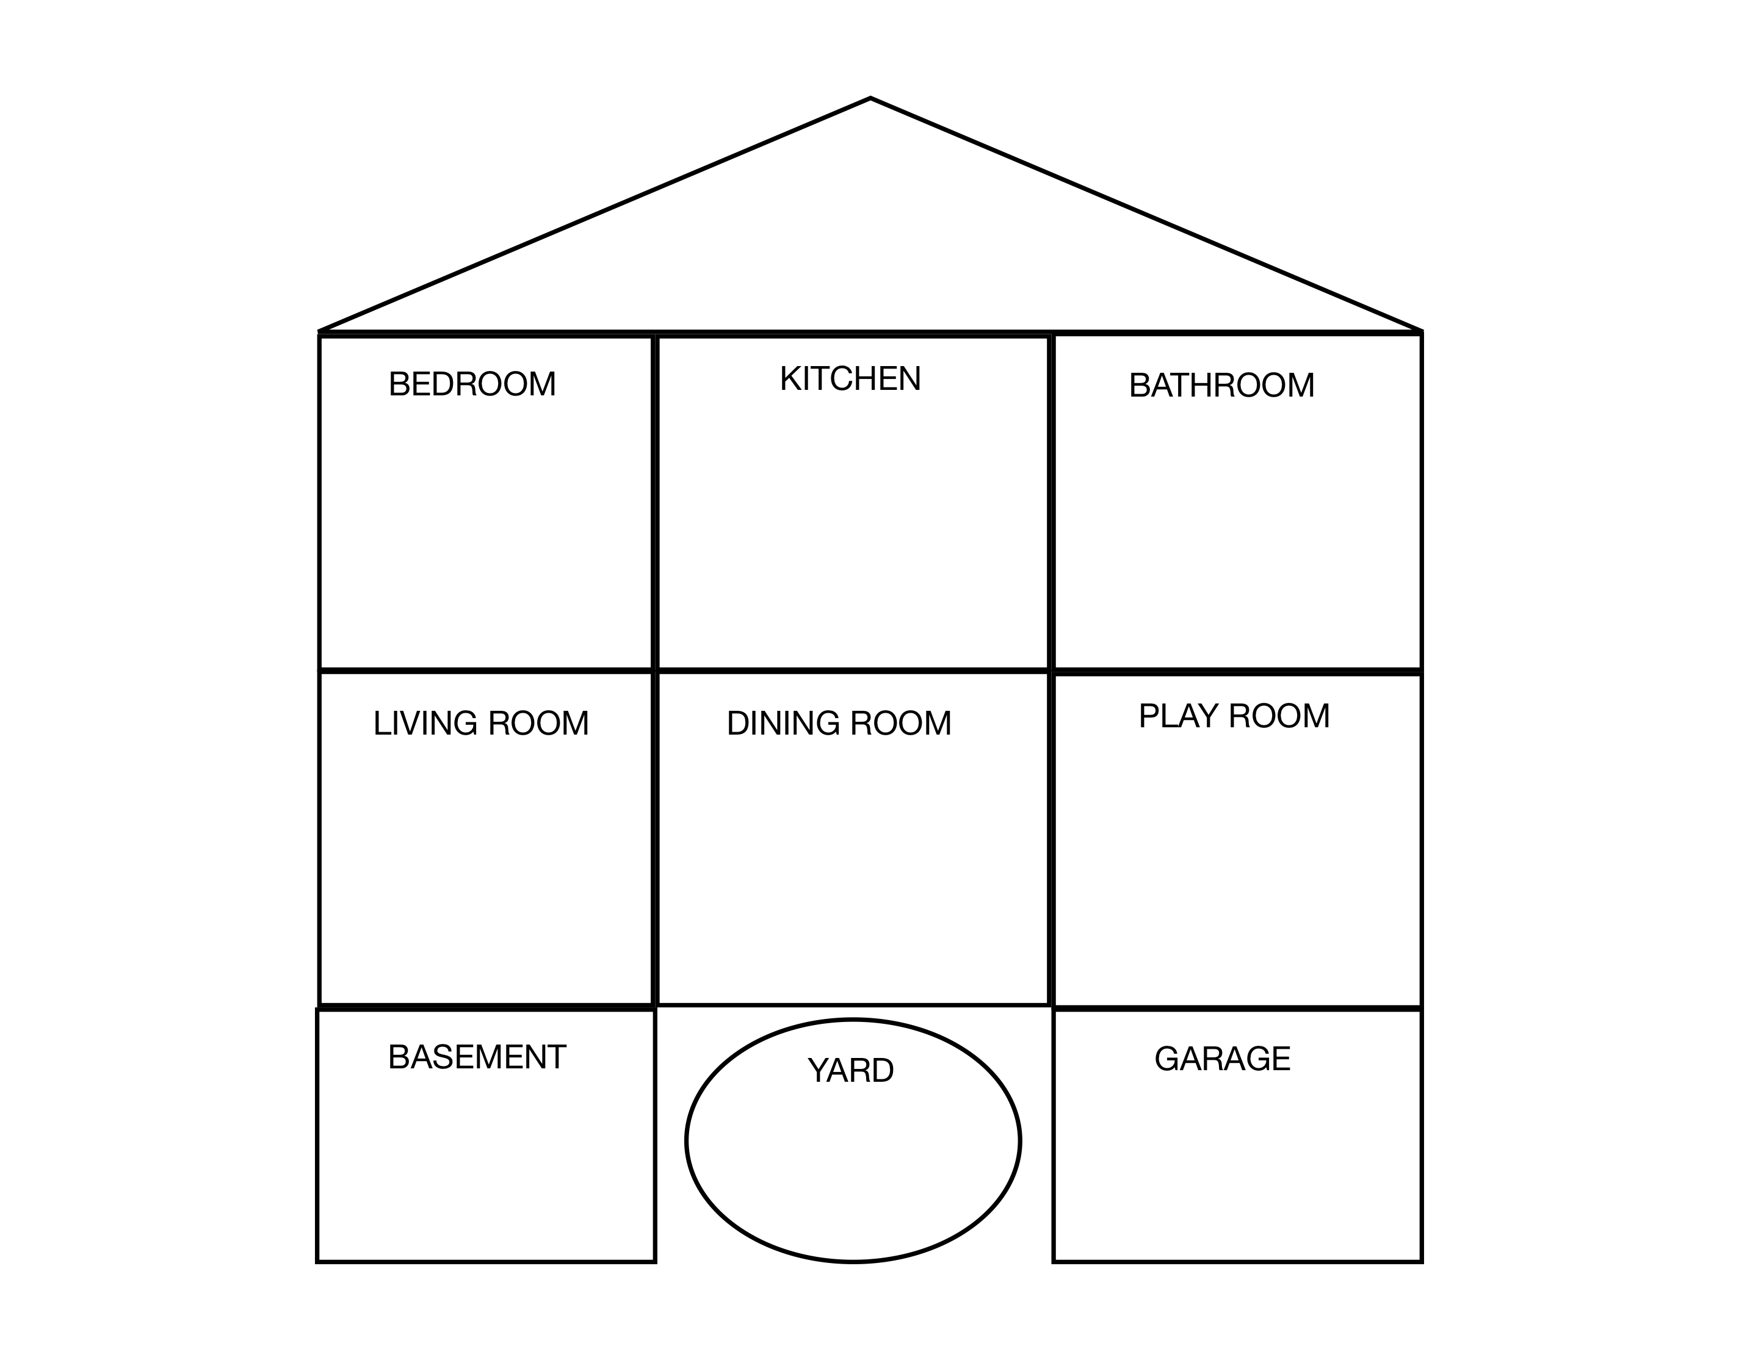

Slide 5
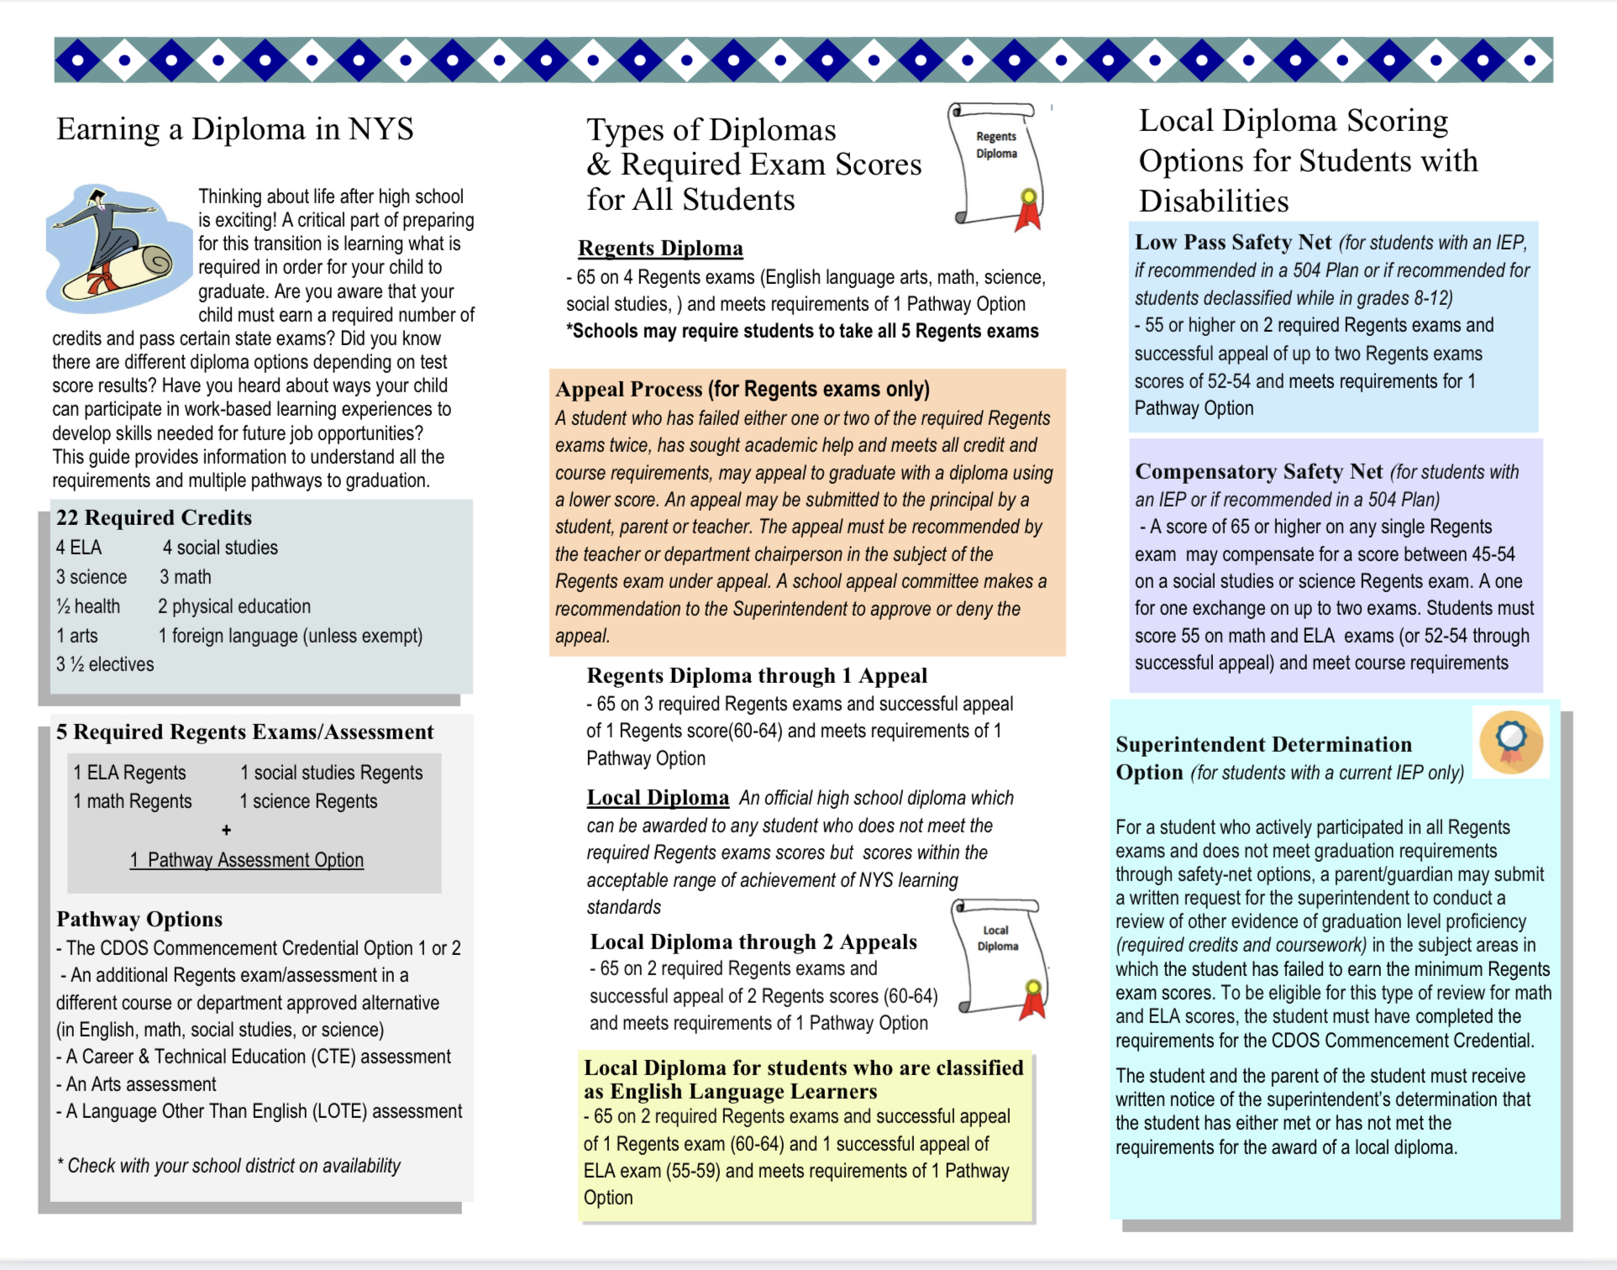

Slide 6
Student
Exit
Summary

Slide 7
Student Exit Summary
•Provided as a sample form to meet the documentation requirements that must accompany the award of the Skills and Achievement Commencement Credential for students with disabilities eligible for the New York State Alternate Assessment (NYSAA)
•Documentation should be based on multiple measures with information gathered over time across a variety of settings, including but not limited to, observation, coursework, community, school and work experiences and transition assessments
•It is recommended that the form be used when transition planning begins (at age 15, or earlier, if appropriate) and be updated annually

Slide 8
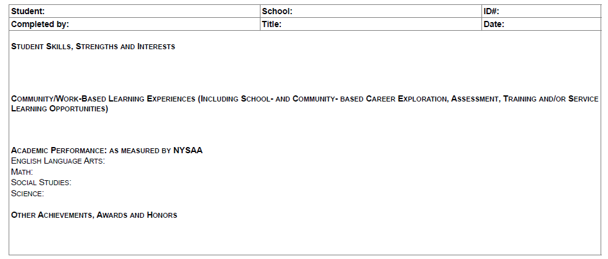
Student Exit Summary Form
form
This document can be used for individual planning, instruction, and benchmarking as early as elementary school.

Slide 9
Levels of Independence in completing tasks

Slide 10
Competencies based on the Career Development and Occupational Studies (CDOS) learning standards
•Career Development: Knowledgeable about the world of work, career options, personal skills, aptitudes, and abilities relating to future career decisions.
•Integrated Learning: Application of academic knowledge and skills to school, community, and home settings.
•Universal Foundation Skills:
•Basic Skills: Ability to read, write, listen, speak and perform arithmetical and mathematical functions.
•Thinking Skills: Ability to use ideas and information to make decisions and solve problems
•Personal Qualities: Ability to self-manage, plan, organize, and take independent action

Slide 11
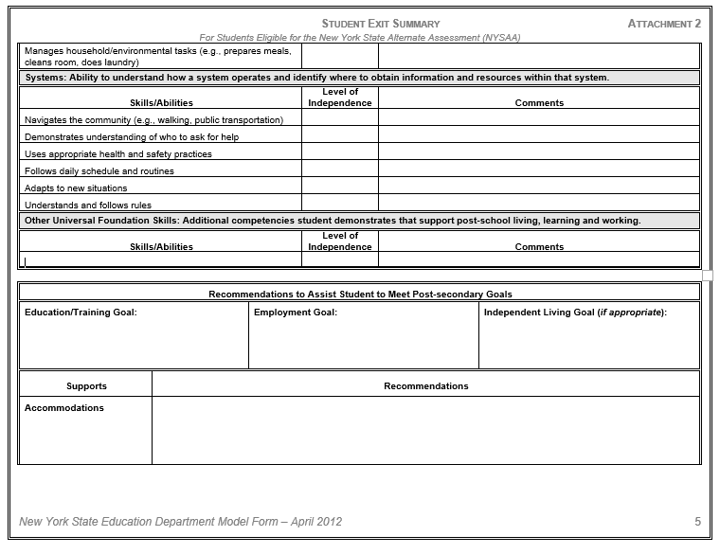
Recommendations to Assist Student to Meet Post-secondary Goals

Slide 12
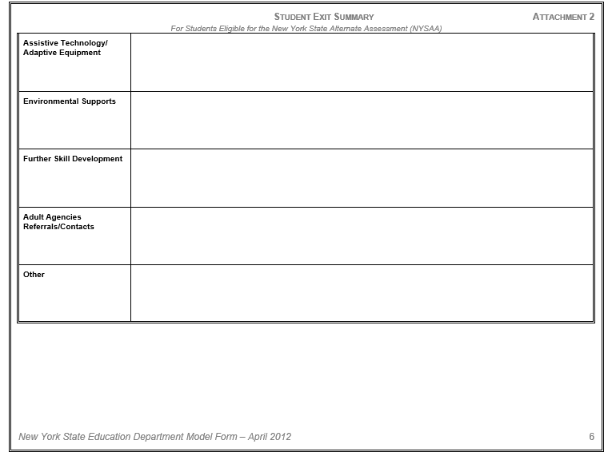
Recommendations to Assist Student to Meet Post-secondary Goals

Slide 14
Student: | School: | ID#:
Completed by: | Title: | Date:
Student Skills, Strengths and Interests Community/Work-Based Learning Experiences (Including School- and Community- based Career Exploration, Assessment, Training and/or Service Learning Opportunities) Academic Performance: as measured by NYSAA English Language Arts: Math: Social Studies: Science: Other Achievements, Awards and Honors
Key Levels of Independence (with the use of assistive technology and accommodations as appropriate)
1: Not Applicable | Student has not had an opportunity or been observed to attempt or complete task.
2: Extensive Support | Student requires ongoing assistance (verbal, physical, visual prompts) and close supervision to complete task.
3: Moderate Support | Student requires frequent assistance (verbal, physical, visual prompts) and periodic supervision to complete task.
4: Minimal Support | Student requires occasional assistance (verbal, physical, visual prompts) and intermittent supervision to complete task.
5: Independent | Student completes task without assistance/supervision.

Slide 15
Career Development: Knowledgeable about the world of work, career options, personal skills, aptitudes, and abilities relating to future career decisions.
Skills/Abilities | Level of Independence | Comments
Exhibits and/or expresses specific interests
Demonstrates abilities related to specific interests
Demonstrates awareness of opportunities for employment and/or other post-secondary activities related to specific interests
Identifies skills needed for post-secondary success
Identifies accommodations needed for post-secondary success
Integrated Learning: Application of academic knowledge and skills to school, community, and home settings.
Skills/Abilities | Level of Independence | Comments
Uses basic academic skills in community/work-based learning experiences (e.g., applies math skills to purchasing items, applies alphabetizing skills to sorting mail)
Demonstrates skills learned in school in a variety of settings (e.g., home, community, workplace)

Slide 16
Universal Foundation Skills
Basic Skills: Ability to read, write, listen, speak and perform arithmetical and mathematical functions.
Skills/Abilities | Level of Independence | Comments
Reading: Identifies and understands texts and symbols (e.g., stop, exit, and restroom signs)
Reading: Identifies vocabulary associated with various jobs (e.g., matches tools to words)
Writing: Creates pictures, symbols and objects and writes words and sentences to communicate information
Listening: Follows one step directions to complete a given task
Listening: Follows two or more step directions to complete a given task
Speaking: Uses language to interact with others (e.g., expresses needs, demonstrates understanding, and interacts socially with others). May include use of augmentative communication, as appropriate.
Math: Demonstrates basic math skills, including counting with one-to-one correspondence, matching similar objects, and understanding concepts of quantity (e.g., more, less, etc.)
Functional Math: Applies basic math skills to daily living (e.g., tells time, manages money)
Thinking Skills: Ability to use ideas and information to make decisions and solve problems.
Skills/Abilities | Level of Independence | Comments
Recognizes that there is a problem and requests assistance
Solves routine problems in daily life (e.g., indicates choice from menu of items, dresses for the weather)
Solves less common problems, such as contacting emergency services (e.g., dial 911)
Demonstrates understanding of cause and effect (e.g., burned when touches hot stove; consequences of inappropriate behavior)
Uses similar skills across a variety of settings (e.g., identifies building exits in different settings)

Slide 17
Personal Qualities: Ability to self-manage, plan, organize, and take independent action.
Skills/Abilities | Level of Independence | Comments
Communicates preferences and needs
Self-regulates during transitions (e.g., waits appropriately, engages in appropriate self-soothing activity in stressful situations)
Transitions appropriately between activities
Manages health (e.g., makes personal and health needs known)
Performs personal care skills
Uses unstructured time appropriately
Interpersonal Skills: Ability to work independently or as part of a team and relate to different people across settings.
Skills/Abilities | Level of Independence | Comments
Asks for help when faced with difficult situations and individuals
Self-advocates (e.g., seeks out and uses supports and accommodations)
Accepts direction from authority figures
Works independently
Works as part of a team
Respects the space and property of others
Demonstrates appropriate behavior across settings
Interacts appropriately with peers and others
Participates in leisure/recreation activities
Technology: Ability to use different types of technology and resources to satisfy personal and societal needs and wants.
Skills/Abilities | Level of Independence | Comments
Identifies the correct tool/technology necessary to complete a given task
Uses basic tools safely and appropriately (e.g., microwave, eating utensils, televisions, assistive technology)

Slide 18
Interpersonal Skills: Ability to work independently or as part of a team and relate to different people across settings.
Skills/Abilities | Level of Independence | Comments
Asks for help when faced with difficult situations and individuals
Self-advocates (e.g., seeks out and uses supports and accommodations)
Accepts direction from authority figures
Works independently
Works as part of a team
Respects the space and property of others
Demonstrates appropriate behavior across settings
Interacts appropriately with peers and others
Participates in leisure/recreation activities
Managing Information: Ability to access and use information.
Skills/Abilities | Level of Independence | Comments
Uses information to make simple decisions (e.g., responds to safety alarms, follows traffic safety rules)
Accesses information from a variety of sources (e.g., internet, grocery ads, orders from a menu)
Managing Resources: Ability to apply financial and human resources and manage time and materials to successfully carry out a planned activity.
Skills/Abilities | Level of Independence | Comments
Selects the appropriate resources to complete a task

Slide 19
Initiates tasks
Remains on task
Completes tasks within existing time limits
Manages household/environmental tasks (e.g., prepares meals, cleans room, does laundry)
Systems: Ability to understand how a system operates and identify where to obtain information and resources within that system.
Skills/Abilities | Level of Independence | Comments
Navigates the community (e.g., walking, public transportation)
Demonstrates understanding of who to ask for help
Uses appropriate health and safety practices
Follows daily schedule and routines
Adapts to new situations
Understands and follows rules
Other Universal Foundation Skills: Additional competencies student demonstrates that support post-school living, learning and working.
Skills/Abilities | Level of Independence | Comments
Recommendations to Assist Student to Meet Post-secondary Goals
Education/Training Goal: |  | Employment Goal: | Independent Living Goal (if appropriate):
Supports | Recommendations
Accommodations
Assistive Technology/ Adaptive Equipment
Environmental Supports
Further Skill Development
Adult Agencies Referrals/Contacts
Other

Slide 20
DAY PROGRAMS
IN ORANGE COUNTY

Slide 21
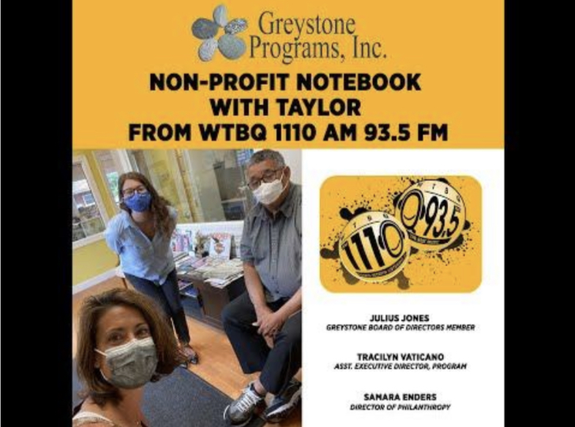
Club ATLAS
In Warwick, NY, Club ATLAS (Advanced Training and Learning for Adult Success) is a transitioning program for Individuals who have “aged-out” of school. Our goal is to assist each Individual to achieve their highest level of independence with support, encouragement, training, education and ample exposure to community opportunities that enhance the quality of their lives. The program emphasizes independent living skills, vocational skills, social skills, community inclusion, and self-advocacy to increase their personal capacity and development. Small structured groups provide help develop and enhance job skills. The interests and talents of the young adults are tapped and paired with activities in the areas of daily living, social, and recreational skills. Dan Feierman, pictured above, is one of our participants. He also works part-time at Greystone. Individuals are involved with the community and volunteer with Meals on Wheels, grocery shopping, friendly visiting, and assisting local Humane Societies. Available in Orange County, the Club ATLAS Day Program supports individuals living with Autism and developmental disabilities as they reach their full potential. For any inquiries, please contact us or call (845) 469-3760.

Slide 25
Pre-Academic/Environmental Awareness: Offers skills for daily living tailored for young adults through adulthood. Senior Center: Provides social, recreational and learning opportunities for persons 50 and older.
Sensory Stimulation: Helps to develop physical, mental and emotional well-being through sensory responses in areas such as balance, strength, coordination, and self-awareness.
Day Habilitation: Empowers individuals with all types of developmental disabilities to discover ways to access and participate in their greater community. The program addresses issues that prevent individuals from true immersion in the community, such as social skills, hygiene and behavioral skills. The program also has a general health and wellness component that addresses weight control, dietary needs, and stress reduction techniques.
Community Builders: Provides true community inclusion for the people we support with the community in which they live. The program started in 2010 as an innovative program for the people in our Day Habilitation program. Transportation is provided to and from the program which takes place throughout the Orange County community. While enjoying the many parks and attractions of the County, program participants also serve their communities by delivering Meals on Wheels to homebound citizens, collecting donations for pet shelters, and partnering with other civic groups to take part in voluntary activities. The program has also organized sessions at Orange County Community College and Mount St. Mary College
Contact: cmurphy@arcghvny.org

Slide 26
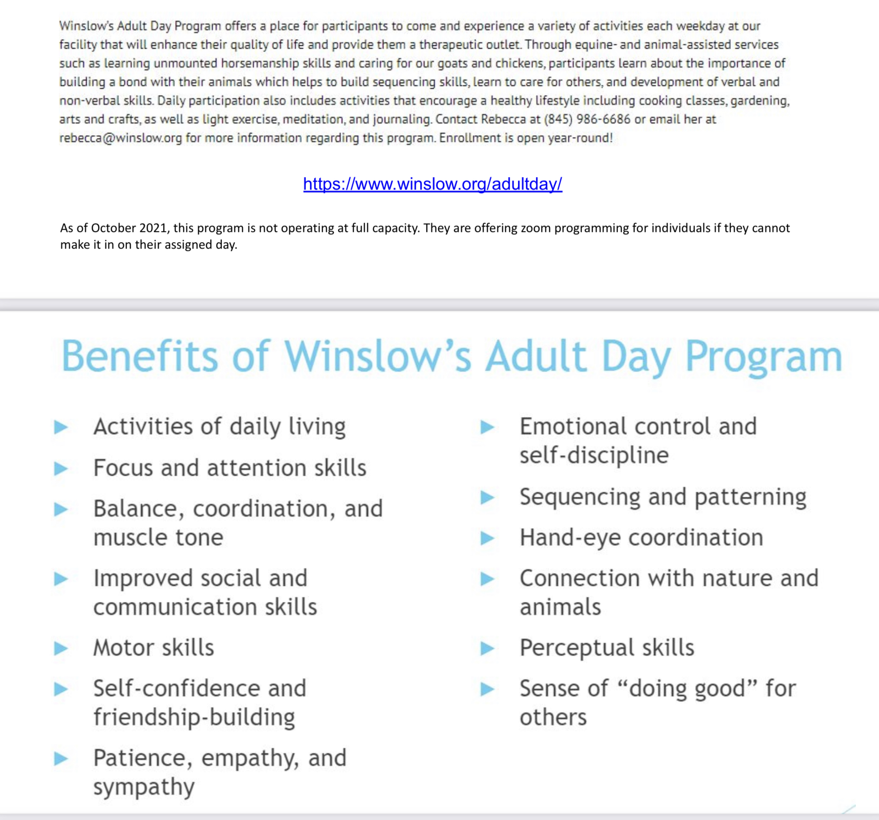

Slide 28
Transition Resources
NY State Agencies
New York State Education Department (NYSED) P-12: Office of Special Education
http://www.p12.nysed.gov/specialed
NYSED Memo: Transition Planning and Services for Students with Disabilities
http://www.p12.nysed.gov/specialed/documents/transition-planning-and-services-for-students-with-disabilities.pdf
New York State Education Department (NYSED) Graduation Requirements
http://www.p12.nysed.gov/specialed/gradrequirements/home.html
Adult Career and Continuing Education Services-Vocational Rehabilitation (ACCES-VR)
http://www.acces.nysed.gov/vr/
Commission for the Blind and Visually Handicapped (NYSCB) http://www.ocfs.state.ny.us/main/cbvh/about.asp
NYS Office for People with Developmental Disabilities (OPWDD) http://www.opwdd.ny.gov/
Office of Mental Health (OMH)
http://www.omh.ny.gov/
Key Transition Resources for Students/Families
I’m Determined http://www.imdetermined.org/
US Dept. of Labor: CareerOneStop (has mobile app) https://www.careeronestop.org/
Khan Academy Career videos https://www.khanacademy.org/college-careers-more/career-content
The Youthhood http://www.youthhood.org/
Going to College http://www.going-to-college.org/
Think College! Inclusive Postsecondary Education programs https://thinkcollege.net/
Autism Speaks-Transition Toolkit https://www.autismspeaks.org/tool-kit/transition-tool-kit
Center for Parent Information & Resources https://www.parentcenterhub.org/

